Slide 1

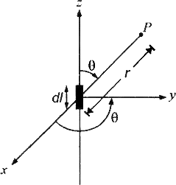


Antenna and Wave Propagation Electromagnetic Spectrum
Analysis of the Radiative Field
Assume an elementary doublet of length dl such that 𝑑𝑙 ≪ (approximately dl =
0.1λ. Hence such antenna called Hertzian antenna) (λ = wavelength of electromagnetic radiation)
Figure (1): An elementary doublet.
This means that the time taken by the signal to travel, across the current element (dl/c) is very much less than the signal period. Thus, the current may be assumed uniform all along the length dl. Assume also, that the end is such that the current has the uniform value throughout its length. Since the doublet carries current, it can be regarded as Faraday's current element and therefore is an induction field due to current.
Magnetic potential at a distance r from this current element is
The current in the doublet oscillatory with frequency 𝜔 = 2𝜋𝑓
There will be a time lag r/c [c is the velocity of electromagnetic propagation] at the point P, so that we may write:-

Slide 2

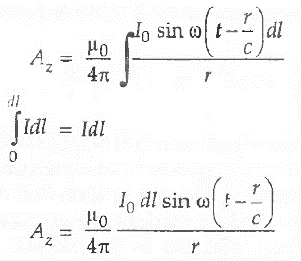
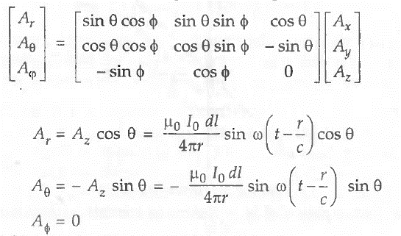
Antenna and Wave Propagation Electromagnetic Spectrum
Referring to figure (1), current element dl is symmetrically placed about the origin with its axis along the z axis, the current on the element has only a z- component, A also has only the Az component. Thus, the magnetic potential at P is
Referring to figure (1) again, it is clear that A has only z-component and
Ax = Ay = 0.
Using the transformation between rectangular and spherical components is:
The magnetic field intensity H can be expressed as:-

Slide 3
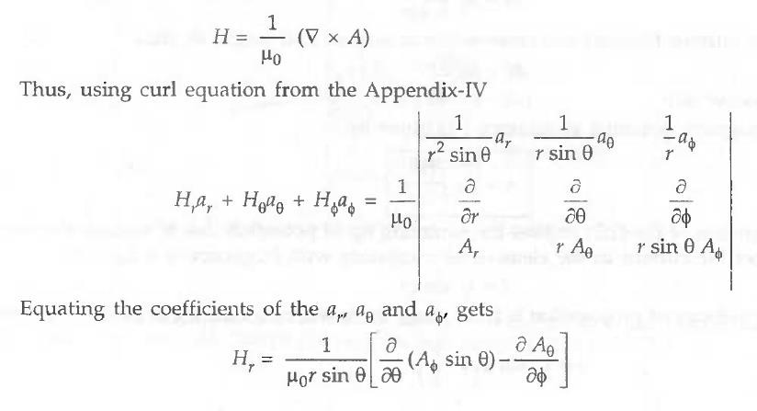
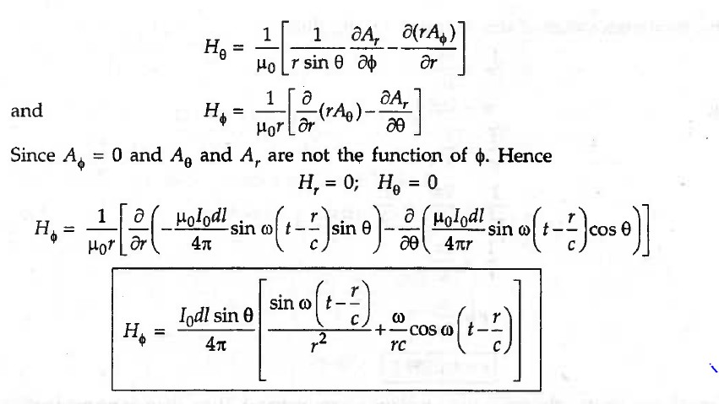
Antenna and Wave Propagation Electromagnetic Spectrum
There are two parts of which:
1
r
1) sin ω (t −
⁄ ) : Which represent the induction field and may be recognized as
_{𝑟}2
c
Ampere's or Biot-Savart's law for retarded propagation.
Induction field represents the energy, which attenuates in an inverse square law method, that is, rapidly with distance. It is felt only within the immediate vicinity of

Slide 4
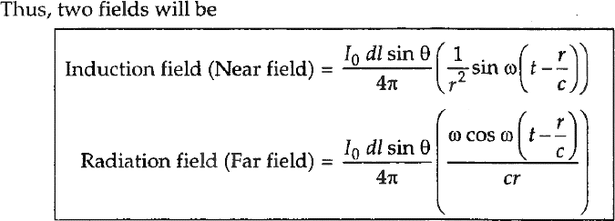
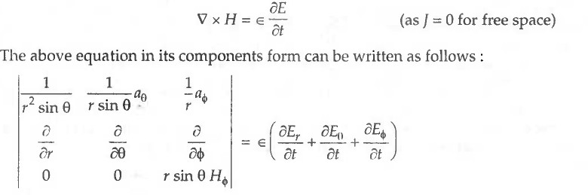
Antenna and Wave Propagation Electromagnetic Spectrum
transmitter. For transmission purposes, it is ignored. This term is energy stored in the field during one quarter of a cycle and returned to the circuit during the next.
𝟐) ^{𝜔} 𝑐𝑜𝑠𝜔(𝑡 − ^{𝑟}⁄_{𝑐}) : Represents the radiative field which is available at the point r.
𝑟𝑐
It is a progressive waveform and is the electromagnetic energy propagated in space.
We generally take only this term into account for radiation. Thus, two fields will be:
In spherical coordinates the fields in x - y plane is symmetrical. Thus, there is
no magnetic field components in elevation and along radial directions, i.e. Hθ = Hr = 0, only the HØ component is present. The electric field intensity £ can be obtaining from magnetic field intensity H by applying Maxwell's first equation for free space:

Slide 5
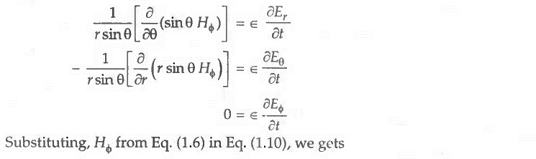
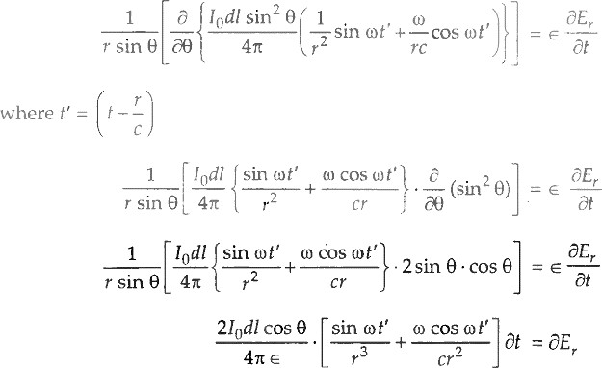
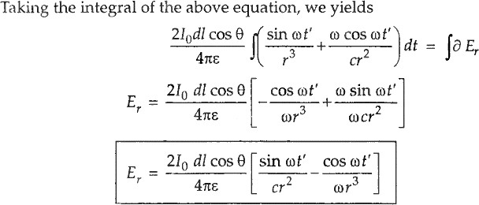
Antenna and Wave Propagation Electromagnetic Spectrum

Slide 6
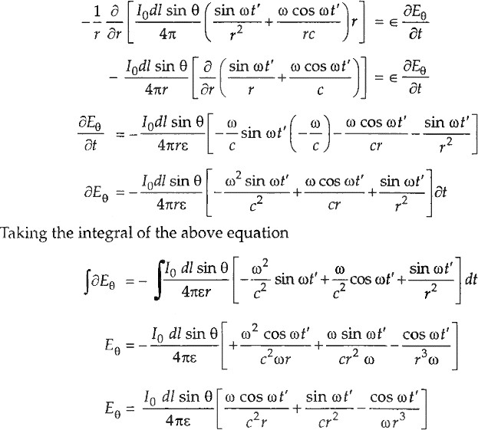
Antenna and Wave Propagation Electromagnetic Spectrum
The electric field strength from a current element along the radial direction for r >> λ is negligible because varying as a function of 1/r² and 1/r³. Hence substituting H^ in equation (1.11) and performing similar operation as before, we obtain:-
Equation above has three terms varying as 1/r, 1/r² and 1/r³, respectively. The second and third terms are induction fields present in the vicinity of current element only, and they start becoming negligible after λ/6, for r >> λ. The
inverse distance (1/r) first, term is the radiating field for r » λ. Thus,

Slide 7


Antenna and Wave Propagation Electromagnetic Spectrum
So, a current element located in space, carrying an oscillatory current gives rise to two radiating field Eθ and HØ the electric field being along the meridian (longitude) of the sphere (0) and the magnetic field along the latitude of the sphere (Ø). Both the fields are perpendicular to each other. By these, following results are obtained:
The field is maximum at the equator and equal to zero at poles.
The field intensities increase with frequency.
Both the fields are in time phase indicating transfer of energy.
They vary with the sine of the angle θ, and thus being maximum at θ = π /2.

